Slide 1
Welcome to all
for the MHRM Online lecture
By
Dr. Dhiraj Ovhal
HOD of Commerce

Slide 2
Chapter -4
Chapter no 4 Key Marketing Dimensions

Slide 3
Q.1 Marketing ethics concept and Unethical practices of marketing ?
Meaning:-
The word ethics is derived from Greek word “ Ethos” which means “ Character’ or “Fundamental Values”.
Ethics is branch of Philosophy which is concerned with ethical values and moral characteristics.
Right product with right price
Right information
No cheating or misleading information • Right channel of promotion
( Way to remember :- -co-ordination of four key variables, )

Slide 4
Unethical practices of marketing
Targeting Children:- Junk foods, Pizza,
Dramatization of children:- Horlics- bourvita- inferiority complex of non use of product
Unhealthy products:- Soft drink, Ice-creams, pizza, burger, etc.
Predatory pricing:- IPHONE,ROLEX Watches- high price
Privacy Concern:- Online data, Whatsaap ,facebook info, etc.
Trade mark Violation:- duplicate products
Data piracy:- Pirated movie , CD
Expiry date concern:-
Celebrity endorsement :- Bollywood, sportsperson are endorse so many products are Unhealthy
Artificial shortage :- Black marketing, hoarding of products

Slide 5
Unethical practices of marketing
1. Targeting Children:- Junk foods, Pizza,
Advertising and promotion targeted to children have an adverse effect on their personality. A famous child specialist (Dr. Allen Varuer observed that children are more diverted towards material goods, which is the result of advertising and promotions that companies use to sell their products and play with human psyche.
Advertising creates materialistic values rather than spiritual ones. A psychologist who specialized in materialism study (Dr. Tim Kassell) said that people who are materialistic are less satisfied and they are not happy with their life, they are much more into drugs and alcohol and they tend to contribute less to their communities,

Slide 6
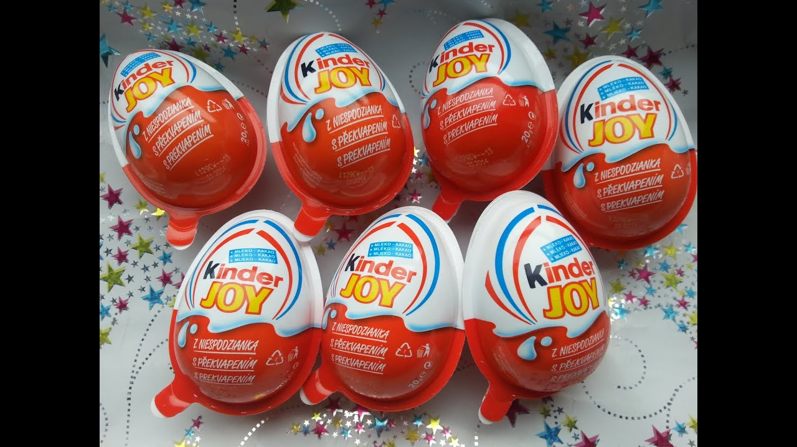
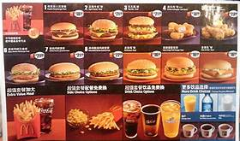
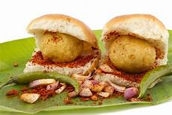
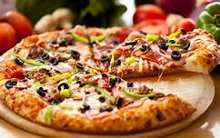
Targeting to children:-

Slide 7
2. Dramatization of children:- Horlics- bourvita- inferiority complex of non use of product
Ads dramatize children as super kids - who excels in studies and sports - simply because they consumes a particular health drink. Quite often, such health drinks do not contribute to the growth of the child.

Slide 8
3.Unhealthy products:- Soft drink, Ice-creams, pizza, burger, etc.
Some firms manufacture and market harmful products such as cigarettes and alcohol and promote them through surrogate ads. Also some firms market unhealthy products such as soft drinks, potato chips and so on. The manufacturing and marketing of harmful products raises ethical issues.

Slide 9
4. Predatory pricing:- IPHONE,ROLEX Watches- high price
Predator pricing by large MNCs to wipe out the competition also raises ethical issues in marketing. Predatory pricing, adversely affects small and medium firms. Especial developing countries a large number of workforce is engaged in small and medium companies, and predatory pricing lead to loss of employment

Slide 10
5.Privacy Concern:- Online data, Whatsaap ,facebook info, etc.
Certain companies such as mobile companies, banks, insurance firms, and others are criticized for sharing (unofficially) customer data with other companies without the explicit permission of the customers. Such instances raise privacy
concerns of the customers.

Slide 11
6.Trade mark Violation:- duplicate products
Trade mark and brand name violations are ubiquitous throughout the developing world. In developing countries there is lack of adequate legal framework to penalize violators. MNCS lose huge sums of money due to trade mark and brand name violations.

Slide 12
Trade mark Violation :-
We must have come across competing brands with similar names,
such as Lux and Lex,
Bata and Bala.
Sintex and Suntex,
Parle-G and Parle C
etc.
Also some sellers may state that their product is of export quality and sometimes they say that their product is made as Japan'. All this is done to fool the customers.

Slide 13
7.Data piracy:- pirated movie cd
Data piracy is a major concern in several countries especially in developing nations. Data piracy costs software, music and movie companies billions of dollars.

Slide 14
8.Expiry date concern:-
There are cases where unethical marketers sell products which have crossed the expiry date by repacking with a new expiry date. At times, they get caught by local authorities, but strict legal action is not taken.

Slide 15
9.Celebrity endorsement :- Bollywood, sportsperson are endorse so many products are Unhealthy
Celebrity endorsement is a major ethical issue in marketing. Most of the time those celebrities are promoted products actually never used the products. The Government need to implement a regulation to penaliseing tall claims about the brands which they are promoting by celebrities

Slide 16
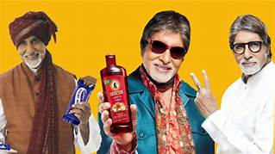
Misuse of testimonials :-

Slide 17
Misuse of testimonials :-
Testimonial is a statement given by a popular personality or any other person claiming the superiority of the brand. In fact, many! advertisers pay handsome amounts of money to extract the statement from a personality even though he/she may not be the user of the product. Take the example of ads of soaps, cosmetics, foods products, etc. You will come across a personality praising the product so much, but in reality she/he must not have used the such products.

Slide 18
10. Artificial shortage :- Black marketing, hoarding of products
Some marketing firms are criticized for artificial shortage and cartel activities. The firms may form a cartel to control supply and to increase prices.
For rxample:- Onion Price,

Slide 19
Unethical practices of marketing
Targeting Children:- Junk foods, Pizza,
Dramatization of children:- Horlics- bourvita- inferiority complex of non use of product
Unhealthy products:- Soft drink, Ice-creams, pizza, burger, etc.
Predatory pricing:- IPHONE,ROLEX Watches- high price
Privacy Concern:- Online data, Whatsaap ,facebook info, etc.
Trade mark Violation:- duplicate products
Data piracy:- pirated movie cd
Expiry date concern:-
Celebrity endorsement :- Bollywood, sportsperson are endorse so many products are Unhealthy
Artificial shortage :- Black marketing, hoarding of products

Slide 20
Thank You

Slide 21
Attendance Link
https://forms.gle/Xqvykv5vfEi1zpyF7
(Mention date at last point)

